Slide 1
HYPERTENSION IN PREGNANCY
DR. MUYIWA AWOLEKE,
CONSULTANT OBSTETRICIAN & GYNAECOLOGIST
DOMINION MEDICAL CENTRE

Slide 2
INTRODUCTION
Out of every 100 pregnant women, between 5 – 10 will have hypertension.
Worldwide, hypertension in pregnancy is responsible for the deaths of about 100,000 mothers every year.
Hypertension can cause problems for the mother or baby; it can result into complications during pregnancy or after delivery!

Slide 3
DEFINITION
HYPERTENSION: Blood pressure of 140/90 mmHg or greater, measured on two occasions at least 6 hours apart.
PROTEINURIA: Urinary protein measurement of ≥ 2+ on a random dipstick evaluation.
ECLAMPSIA:
Hypertension + Proteinuria with Convulsions in pregnancy

Slide 4
RISK FACTORS - 1
Hypertension does not occur in pregnancy just because of:
Stress
Too much thinking
Not having adequate sleep
Salt intake

Slide 5
RISK FACTORS - 2
PRIMIGRAVIDA – A woman getting pregnant for the first time
AGE <20 or > 40years
NEW SPOUSE
FAMILY HISTORY OF HYPERTENSION
PREVIOUS OCCURRENCE IN PAST PREGNANCIES
MULTIPLE PREGNANCY
DIABETES MELLITUS
BMI > 35

Slide 6
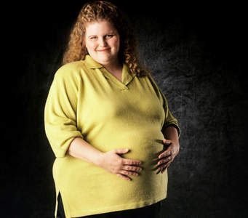

Slide 7
CLASSES
Pregnancy-induced Hypertension:
Pre-eclampsia
Chronic hypertension in pregnancy
Chronic hypertension with superimposed pre-eclampsia

Slide 8
CLASSES - 2
CLASS | BEFORE | PREGNANCY | LABOUR | WITHIN 6 WEEKS | AFTER 6 WEEKS | PROTEIN
PIH | NO | YES | YES | YES | NO | NO
PRE-ECLAMPSIA (PE) | NO | YES | YES | YES | NO | YES
CHRONIC | YES | YES | YES | YES | YES | NO
CHRONIC + PE | YES | YES | YES | YES | YES | YES

Slide 9
MANIFESTATIONS
Hypertension in pregnancy DOES NOT usually manifest with symptoms.
However, by the time the woman starts having symptoms, it means the problem has really become serious!
She must receive specialized care to prevent complications for mother and baby.

Slide 10
MANIFESTATIONS - 2
Reduced urine output
Headache
Blurring of the vision. ‘Flashes of light.’ Temporary blindness
Epigastric or right upper abdominal pain

Slide 11
TREATMENT
ADMISSION into the Hospital, especially with symptoms
BLOOD PRESSURE CONTROL
CONTROL/PREVENT CONVULSIONS
DELIVERY OF THE BABY: This is the ONLY cure for hypertension in pregnancy!

Slide 12


Slide 13


Slide 14


Slide 15
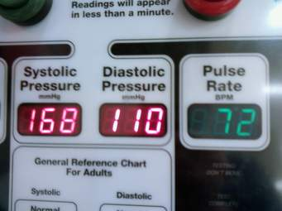

Slide 16
COMPLICATIONS
  Eclampsia (convulsions in the woman)
  Stroke
  Kidney failure, Heart failure, or Liver problems
  Bleeding disorder
  Premature separation of the placenta
  Recurrent pre-eclampsia in next pregnancies
  Reduced growth of the baby
  Death of the baby in the womb
  Premature delivery of the baby

Slide 17
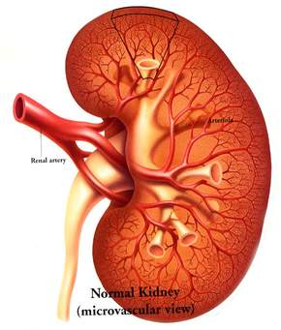

Slide 18
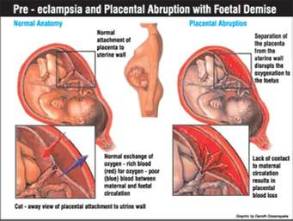

Slide 19
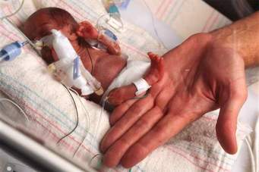

Slide 20
PREVENTION
Early booking for antenatal care
Avoid alcohol intake during pregnancy
Use of low-dose aspirin
Control blood pressure before or in early pregnancy
Control other conditions like diabetes etc.

Slide 21
THANK YOU!

